Slide 1
BLM2041 Signals and Systems
Syllabus
The Instructors:
Doç. Dr. Ali Can Karaca
ackaraca@yildiz.edu.tr
Dr. Öğr. Üyesi Erkan Uslu
euslu@yildiz.edu.tr
2425 Bilg. Müh. için Sinyaller ve Sistemler | Genel | Microsoft Teams
1
Notes:
1

Slide 2
Course Details
Course Code : BLM 2041
Course Name:
Signals and Systems for Computer Engineers
(Bilgisayar Mühendisleri için Sinyaller ve Sistemler)
Instructor :
1- Doç. Dr. Ali Can Karaca
2- Dr. Öğr. Üyesi Erkan Uslu
2

Slide 3
Assesment
Method Quantity (%)
Homework 2 20
Quiz 1 10
Midterm Exam 1 30
Final Exam 1 40
Attendance & participation - 00
By University Rule:
Your average < 40 🡪 FF
3

Slide 4
Course Outline
1. Introduction.
Mathematical Representation of Signals. Mathematical Representation of Systems.
2. Sinusoids.
Review of Sine and Cosine Functions. Sinusoidal Signals. Sampling and Plotting Sinusoids. Complex Exponentials and Phasors. Phasor Addition. Time Signals.
3. Spectrum Representation.
The Spectrum of a Sum of Sinusoids. Beat Notes. Periodic Waveforms. Fourier Series Analysis and Synthesis. Time-Frequency Spectrum. Frequency Modulation.
4. Sampling and Aliasing.
Sampling. Spectrum View of Sampling and Reconstruction. Discrete-to-Continuous Conversion. The Sampling Theorem.
5. Continuous-Time LTI Systems and the Convolution Integral.
Establishing a General Input-Output Relationship. Working with the Convolution Integral.
6. Discrete-Time LTI Systems and the Convolution Sum.
Specializing the Input/Output Relationship. Working with the convolution Sum.
7. LTI System Differential and Difference Equations in the Time Domain.
Obtaining the differential/difference equations for the input-output relations of systems. Solution of differential and discrete equations in the time domain.
4

Slide 5
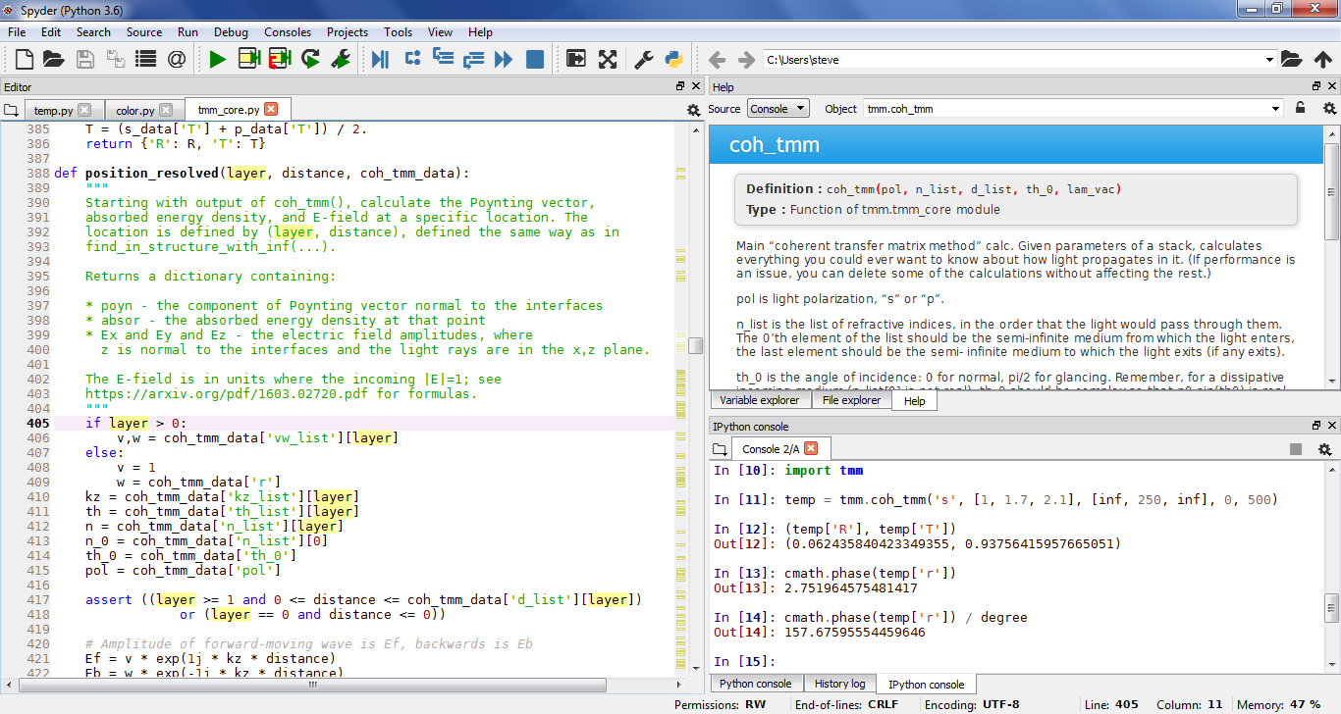
Spyder (IDE for PYTHON)
5

Slide 6
Course Outline
8. The Fourier Transform for Continuous-Time Signals and Systems.
Continuous-Time Aperiodic Signals. Continuous-Time Fourier Transform. Properties of Continuous-Time Fourier Transform.
9. The Discrete Time Fourier Transform for Discrete-Time Signals.
Discrete-Time Aperiodic Signals. Discrete-Time Fourier Transform. Properties of Discrete-Time Fourier Transform
10. The Laplace Transform for Continuous Time.
Laplace Transform. Common Laplace Transforms. Properties Of the Laplace Transform. Inverse Laplace Transform. Poles and Zeros in the s-plane.
11. The Z Transform for Discrete Time.
Z Transform. Common Z Transforms. Properties Of the Z Transform. Inverse Z Transform. Poles and Zeros in the z-plane.
6

Slide 7
COURSE OBJECTIVES
Students will be able to:
Understand mathematical descriptions of Signals and Systems
Express those descriptions as computer implementations (MATLAB, OCTAVE, SCILAB, R, PYTHON )
Yıldız Technical University provides MATLAB License.
OCTAVE, SCILAB, R and PYTHON are free
7

Slide 8
COURSE OBJECTIVES
MATLAB
https://www.mathworks.com/
SCILAB
https://www.scilab.org/
OCTAVE
https://www.gnu.org/software/octave/
R
https://www.r-project.org/
PYTHON
https://www.python.org/
8

Slide 9
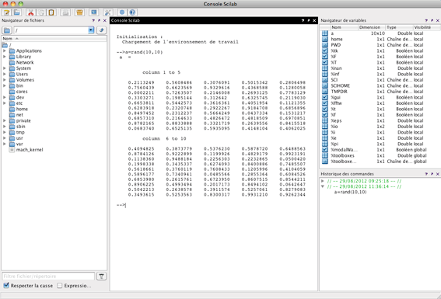
SCILAB environmet
9

Slide 10
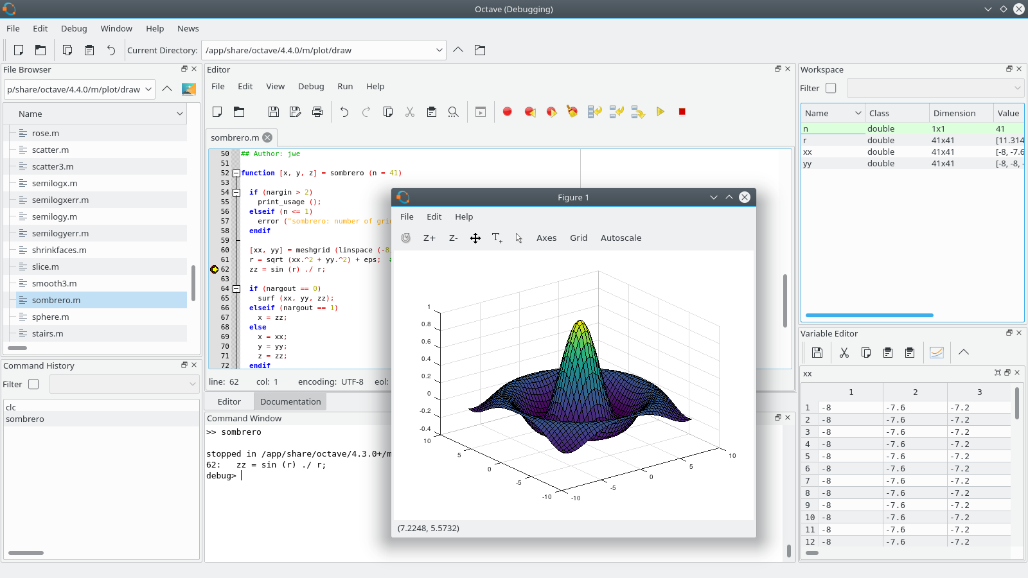
OCTAVE environment
10

Slide 11
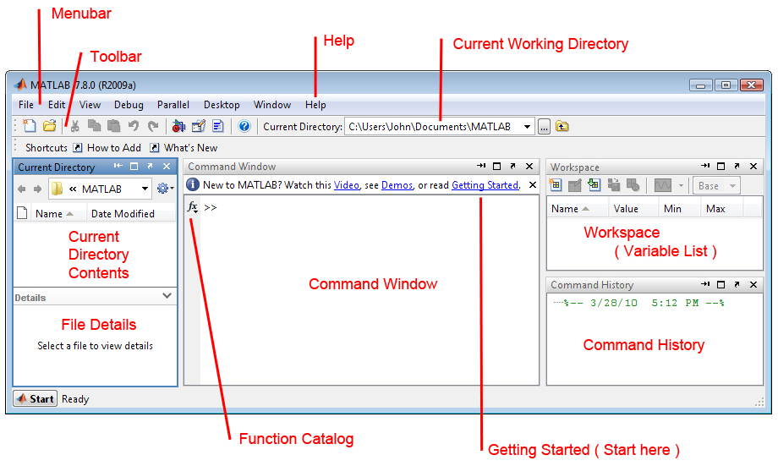
MATLAB environment
11

Slide 12
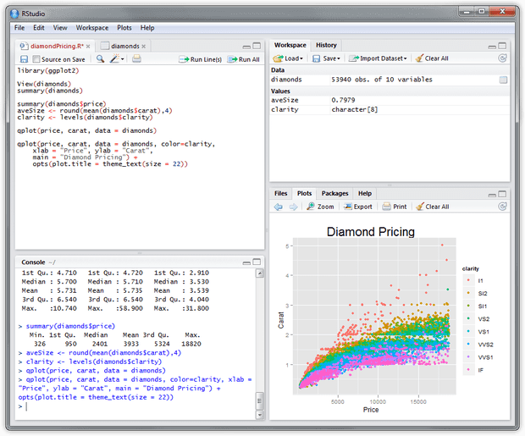
Rstudio (IDE for R)
12

Slide 13
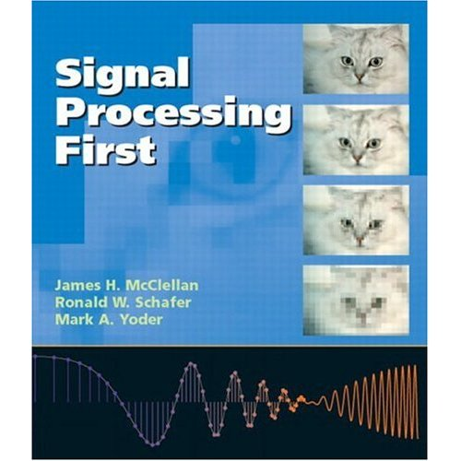
Main course book
Signal Processing First
by James H McClellan, Ronald W. Schaffer and Mark A. Yoder.
Published by Prentice Hall.
Isbn: 0-13-120265-0
13

Slide 14
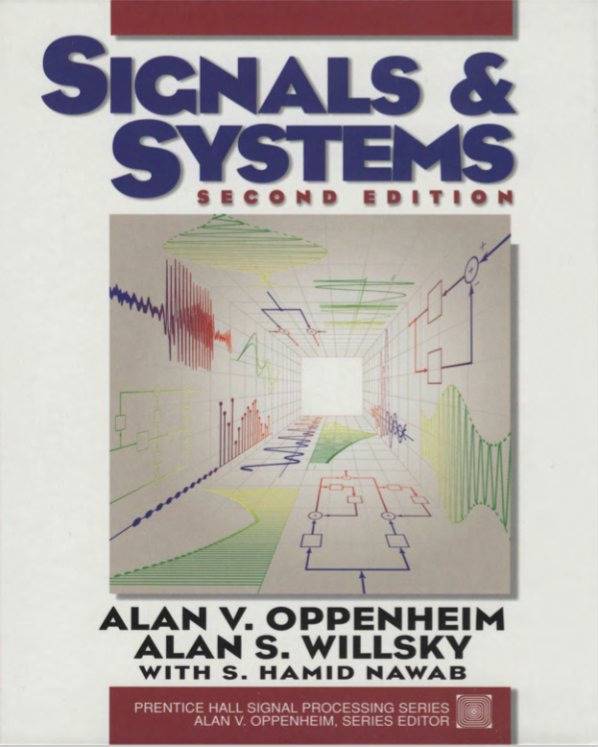
Some Other Books
by Alan. V. Oppenheim and Alan S. Willsky
Oppenheim, Alan V., Alan S. Willsky, and Syed Hamid Nawab. "Signals and systems 2nd ed." New Jersey: Prentice Hall(1997).
14

Slide 15
Course Objectives (In details)
15/7
Academic knowledge
Students will be able to:
Understand and develop simple mathematical models for representing signals and systems
Understand the relationship between time and frequency domain models of dynamic systems
Convert time to frequency-domain models and vice versa
Understand the relationship between continuous and discrete-time models
Intellectual skills
Students will be able to:
Build a mathematical model from a real-life problem related to signals and systems
Interpret results achieved by mathematical solutions
Practical skills
Students will be able to:
Express models and methods as computer implementations (MATLAB or OCTAVE)
Yıldız Technical University provides MATLAB License.
Apply Matlab/Octave for analysis and simulation of continuous and discrete time systems
Analyse mathematical solutions in the context of the original problem
Transferable skills
Students will be able to:
Choose appropriate approach in problem solving situation
Present and communicate formalised results and conclusions

Slide 16
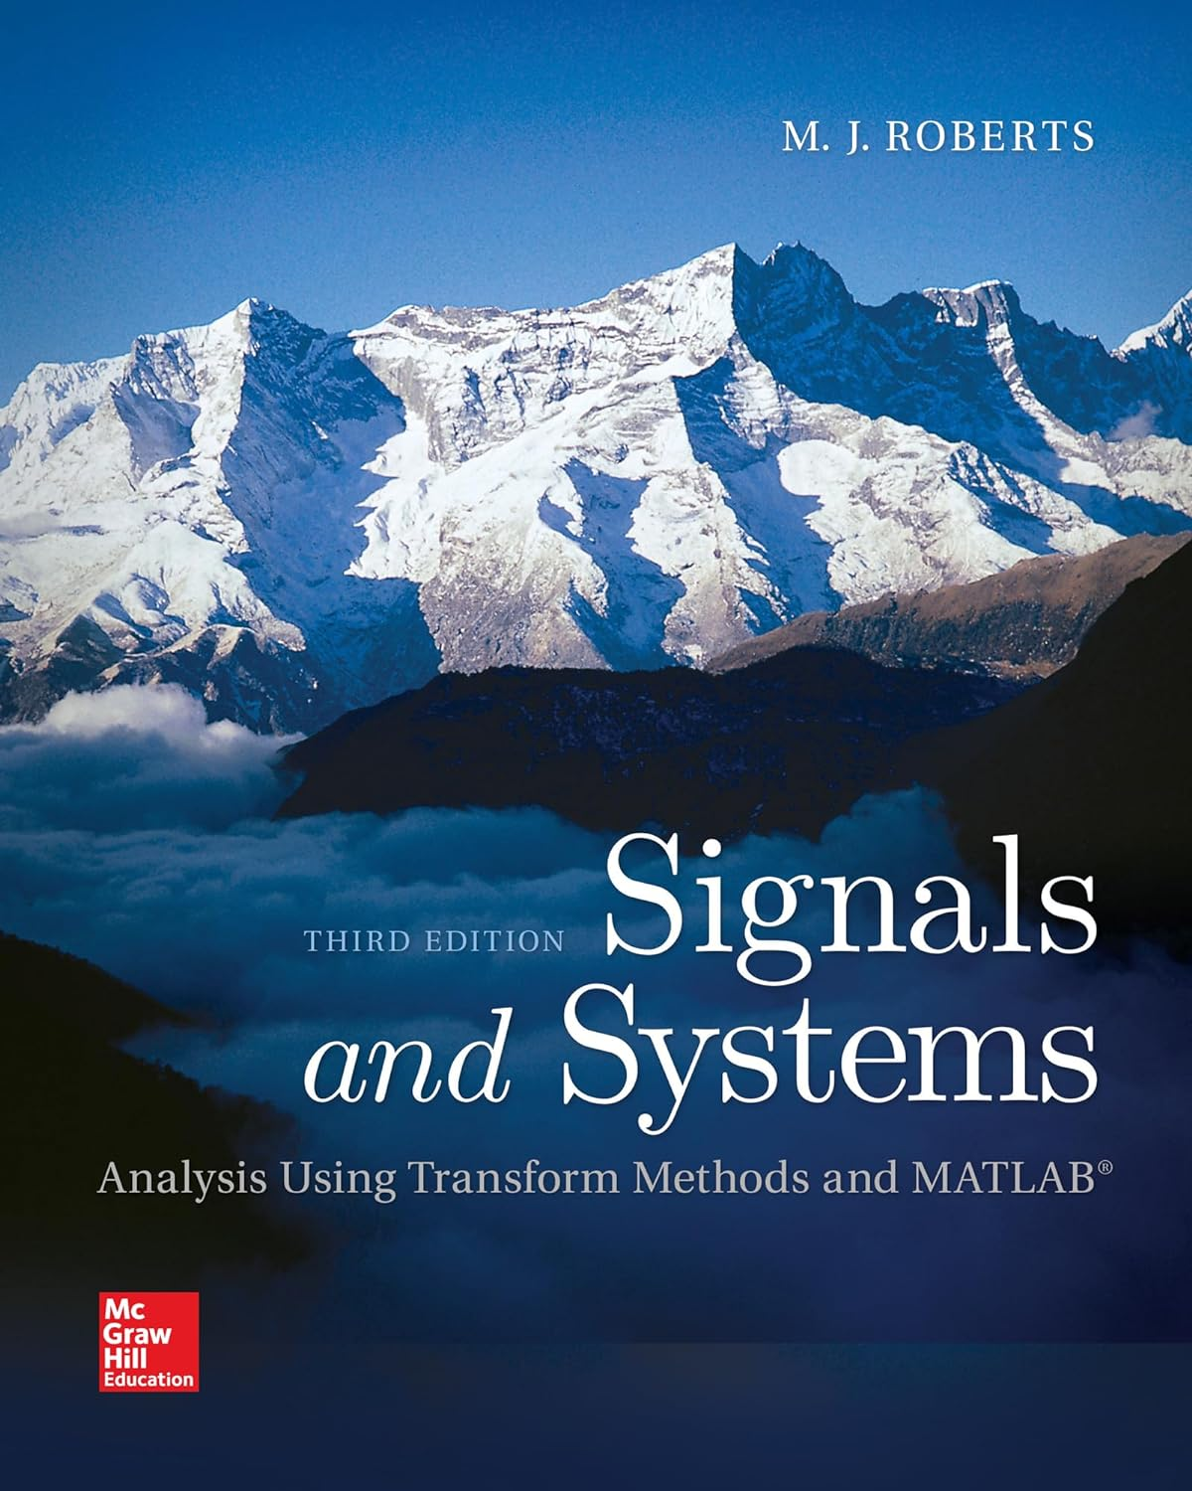
Some Other Books
by M.J. Roberts
Signals and Systems: Analysis Using Transform Methods & MATLAB
16

Slide 17
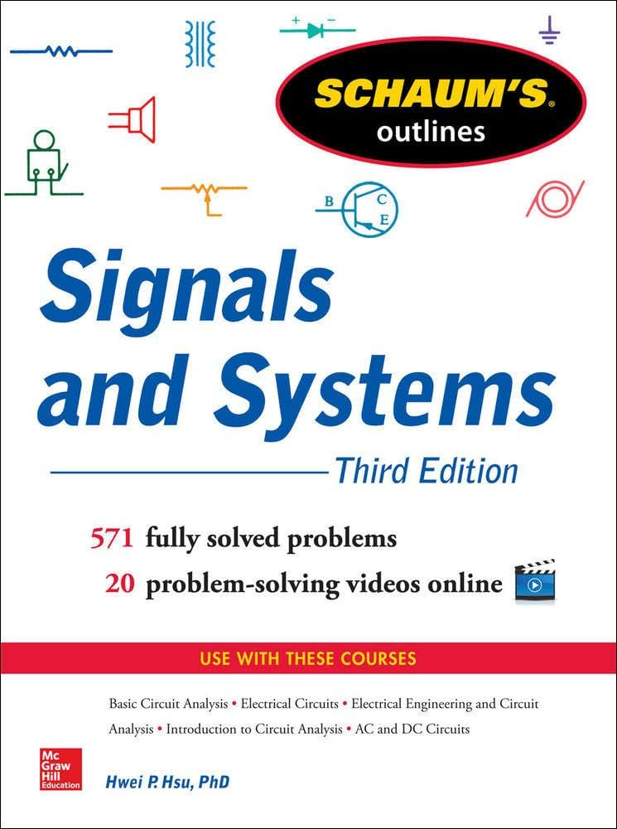
Some Other Books
- by Hwei Hsu
Schaum's Outline of Signals and Systems, 2nd or 3rd Edition
17

Slide 18
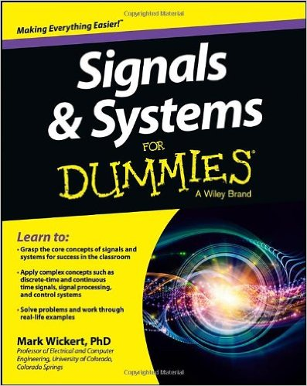
Some Other Books
- by Mark Wickert
Wickert, Mark. Signals and Systems for Dummies. John Wiley & Sons, 2013.
18

Slide 19
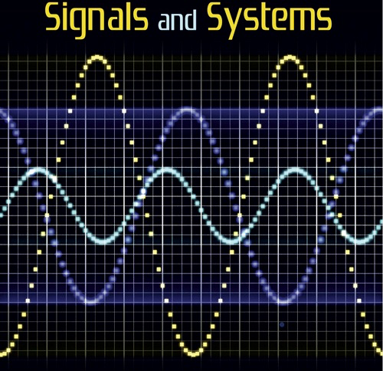

Some Other Books
- Online e-book by Richard Baraniuk
https://cnx.org/contents/d2CEAGW5
19

Slide 20
Rules of the Conduct
No eating /drinking in class
except water
Cell phones must be kept outside of class or switched-off during class
If your cell-phone rings during class or you use it in any way, you will be asked to leave and counted as unexcused absent.
No web surfing and/or unrelated use of computers,
when computers are used in class or lab.
20

Slide 21
Rules of the Conduct
You are responsible for checking the class web page often for announcements.
Academic dishonesty and cheating will not be tolerated and will be dealt with according to university rules and regulations
Presenting any work, or a portion thereof, that does not belong to you is considered academic dishonesty.
University rules and regulations:
http://www.ogi.yildiz.edu.tr/category.php?id=17
https://www.yok.gov.tr/content/view/544/230/lang,tr_TR/
21
Notes:
Dishonesty -> sahtekarlık
Size ait olmayan herhangi bir çalışmayı veya bir kısmını sunmak akademik sahtekârlık olarak kabul edilir.
21

Slide 22
Attendance Policy
The requirement for attendance is 70%.
Absent in at least two exams 🡪 F0
22

